Slide 1


A Secure Aware Efficient Routing Protocol for Efficient and Reliable FPANETS
GUIDE :
Dr. P. AROCKIA MARY Prof./IT
TEAM MEMBERS :
BALAJI S
DEEPAK R
ARAVINTH R
NAVADEEPAK C
1

Slide 2
ABSTRACT
In recent years, the capabilities and roles of Unmanned Aerial Vehicles (UAVs) have rapidly evolved,The focus is use of multiple UAVs, which are integrated into teams that can coordinate to achieve high-level goals.
Setting up an ad-hoc network between flying UAVs is a challenging issue, and requirements can differ from traditional networks, Mobile Ad-hoc Networks (MANETs) and flying Ad-hoc Networks with flower pollination algorithm protocol (FPANETs) in terms of node mobility, shortest path, end to end delay connectivity, security routing, service quality, application areas, etc.
This project identifies the challenges with using UAVs as relay nodes in an ad-hoc manner, introduces network models of UAVs, and depicts open research issues with analyzing opportunities and future work.
2

Slide 3
INTRODUCTION
The growing capabilities of UAVs are opening doors for coordinated teams to tackle complex tasks. This requires innovative networking solutions that can function on these highly mobile platforms. Unlike traditional networks, these UAV ad-hoc networks (UAVANETs) face unique challenges due to factors like rapid movement and dynamic network structures.
This project delves into the challenges and opportunities of using UAVs as relay nodes in an ad-hoc manner. It explores new network models specifically designed for UAVs and identifies key areas for future research to unlock the full potential of cooperative UAV teams.
3

Slide 4
OBJECTIVE
The aim of this proposal is to design maximum throughput communication framework using UAVs
To reduce power consumption, number of nodes, Time
To increase efficiency of system
4

Slide 5
LITERATURE SURVEY
TITLE | AUTHOR | MERITS | DEMERITS | YEAR
Wireless network design for control systems | P. Park, S. Coleri Ergen, C. Fischione | Circular disc monopole wireless networks for future ultra wideband (UWB) applications | Half duplex only implemented and short range protocol only implemented | 2018
Intravehicular energy harvesting wireless networks: Reducing costs and emissions | S. Coleri Ergen | The design of a novel UWB rectangular patch network A simple narrowband power networks | Energy losses are high | 2017
Minimum length scheduling with packet traffic demands in wireless networks | Y. Sadi and S. Coleri Ergen | Presented an original lightweight, low-cost, planar antennas with short-circuited elements, fed by coaxial probe, for dual-frequency (S-antenna) and wide-band applications | More time consumption | 2014
5

Slide 6
LITERATURE SURVEY
TITLE | AUTHOR | MERITS | DEMERITS | YEAR
Wireless power transfer and applications to sensor networks | L. Xie, Y. Shi, Y. T. Hou, | Low-cost, Planar antennas with short-circuited elements, fed by coaxial probe, for dual-frequency (S-antenna) and wide-band applicable | End to end delay is more | 2013
End-to-end reliability-aware scheduling for wireless sensor networks | F. Dobslaw, T. Zhang, and M. Gidlund | A compact ultra wideband (UWB) communication with a band-notch function for internet applications. | More number of nodes are used so end to end delay is high | 2016
“Prospects of tunnel fets in the design of power management circuits for weak energy harvesting dc sources, | D. N. Cavalheiro | Wide-band applicable and presented an original lightweight | More time consumption and Energy consumption | 2018
6

Slide 7
EXISTING SYSTEM
Existing system Minimum Length Scheduling Problem(OSLR) scheme for mobile network wireless communication in which this communication is not efficient
The security analysis shows that the proposed scheme is insecure. In addition, we test the formal security verification of the proposed scheme using the widely-accepted FANET tool to show the proposed scheme is also secure against the replay and man-in-the middle attacks
In order to maintain the accuracy of the query result, nodes reply with k data items with the highest score along multiple routes.
After detecting attacks, the query-issuing node tries to identify the malicious nodes through message exchanges with other nodes.
7

Slide 8
DISADVANTAGES
Discovered routes by these algorithms may neither be energy-efficient nor be reliable.
System security is low
No improved Energy Efficiency
8

Slide 9
PROPOSED SYSTEM
This paper proposes a UAV position-based modified FPA routing protocol for efficient in data security, which deals with high mobility, topological changes, and energy constraint issues in the existing protocols.
Because FPA is a symmetric algorithm, the same procedure is used for decryption as well as encryption.
Embedded network security with single-chip all-encapsulated encryption modules.High-gain, rugged, and lower cost multi-directional antennas.
Highly efficient radios for low bandwidth and full-time high-speed communications links with better shortest path .
9

Slide 10
ADVANTAGES
Algorithms that consider the reliability of links to find more reliable routes.
Algorithms that aim at finding energy-efficient routes
Algorithms that try to prolong the network lifetime by finding routes consisting of nodes with a higher level of battery energy
Algorithms that has more security options .
10

Slide 11
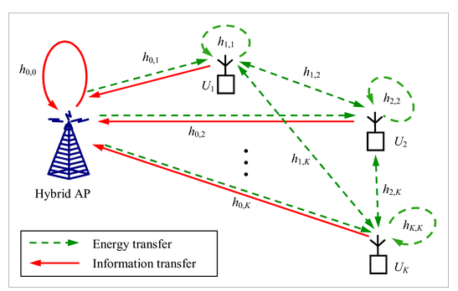
SYSTEM ARCHITECTURE
11

Slide 12
MODULES
UAV Network Deployment
Data Communication
Trust Computation
FPA implementation
Encryption and Decryption
Performance Analysis Result
12

Slide 13
MODULES EXPLANATION

Slide 14
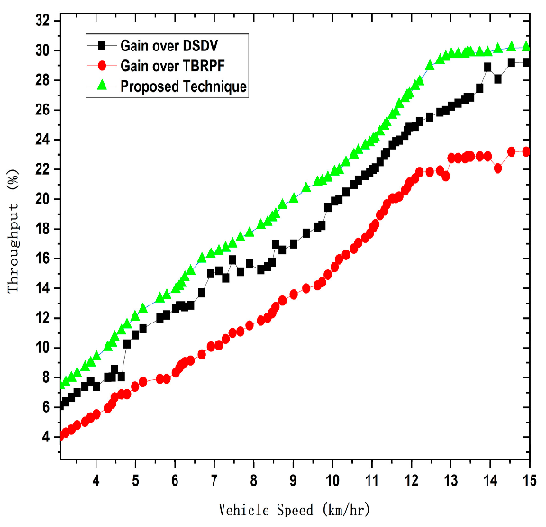
RESULTS:
THROUGHPUT VS VEHICLE SPEED

Slide 15
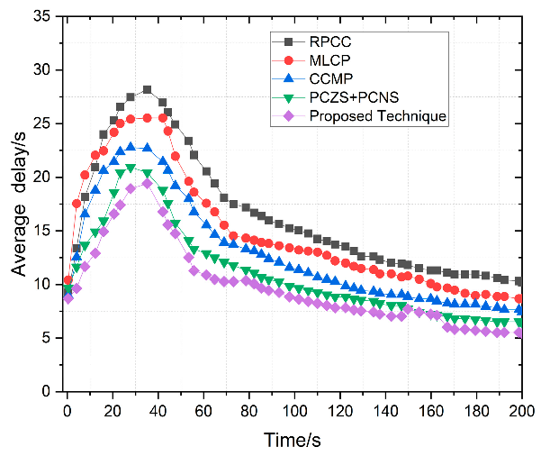
AVERAGE DELAY VS TIME

Slide 16
CONCLUSION
UAV technology is rapidly advancing, with a growing emphasis on coordinated teams. However, this coordination hinges on robust networking models that function within highly mobile environments. Existing mobile ad-hoc network solutions (MANETs) and their flying counterparts (FPANETs) may not fully address the unique demands of UAV swarms. These demands include factors like dynamic node mobility, optimized pathfinding, minimizing delay, and robust security.
This project highlights the challenges associated with UAVs as mobile relay nodes and the need for novel network models. By identifying open research areas and future work, this project paves the way for innovative solutions that will unlock the full potential of coordinated UAV operations.
16

Slide 17
REFERENCE
17

Slide 18
THANK YOU!!
18

